Slide 1



p5.js Pong Workshop
+
+
Prepare to be enlightened :)

Slide 2
So what is p5.js??
It’s a Javascript library for creating visual projects, including graphical interfaces and games.
p5.js is a Processing port for website development
p5.js uses HTML to implement these graphics on a website

Slide 3

So what are we gonna use to code? (IDE)
Repl.it!! - An online integrated development environment perfect for our needs

Slide 4
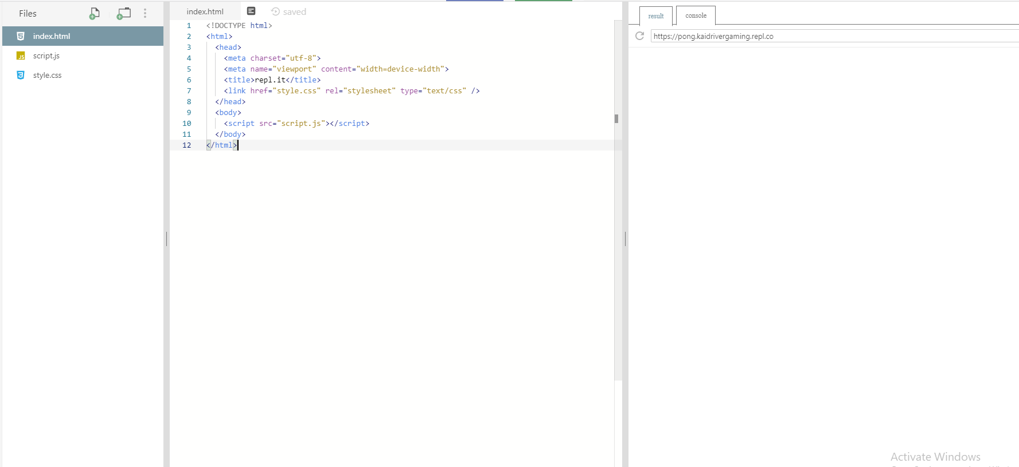
Create a Repl.it account and open a repository!
Go to repl.it
Press “sign-up” and log in with google
Create a “new repl”
Select HTML, CSS, JS and choose a project name
If you screen looks like this, you’re all set!

Slide 5
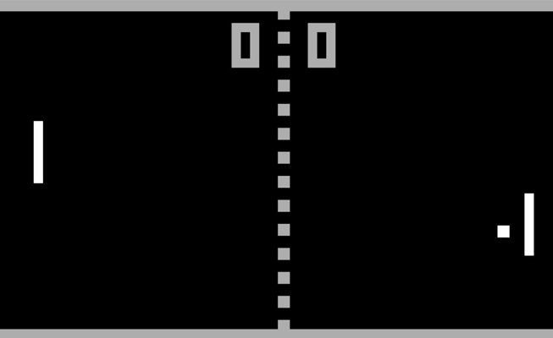
So… what are we making?
Everyone loves games...
Everyone loves simplicity...
So we are creating the classic game of pong!
p5.js is perfect for creating 2D games like pong as it is really easy to create simple graphics, capture user input, and control object movement.

Slide 6
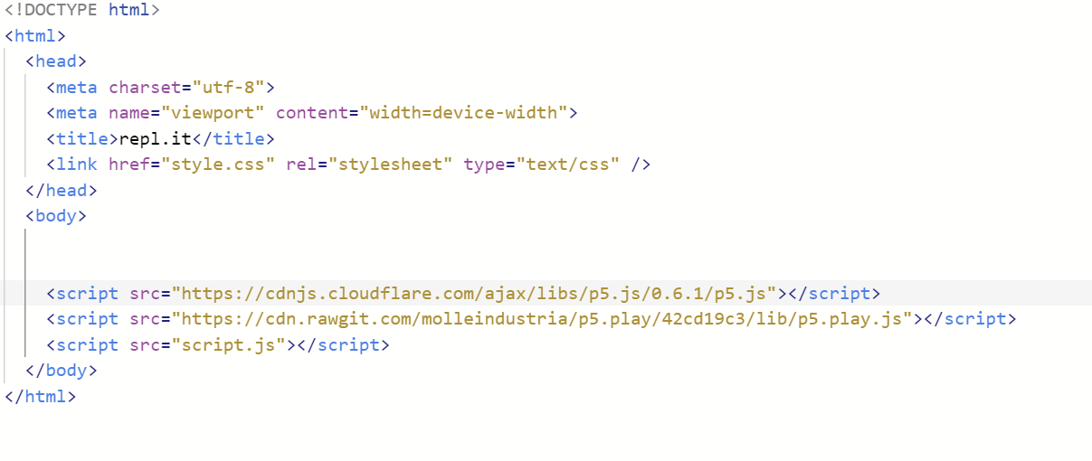
Alright, let’s begin coding!!!
Start with adding the three script tags in the HTML file:
<script src="https://cdnjs.cloudflare.com/ajax/libs/p5.js/0.6.1/p5.js"></script>
<script src="https://cdn.rawgit.com/molleindustria/p5.play/42cd19c3/lib/p5.play.js"></script>
<script src="script.js"></script>
These tags will ensure that your p5.js project is linked to the HTML and displayed on the website.

Slide 7
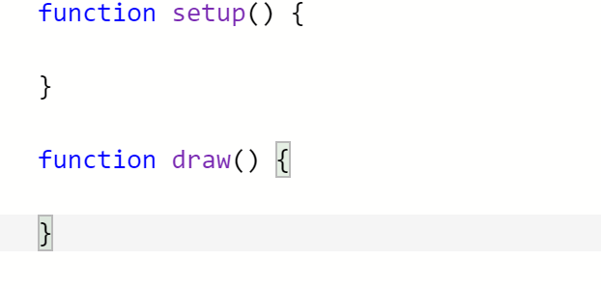
Go back to the script.js file
There are a couple of basic layout functions you need to know about p5:
Setup: This executes before the program runs, and it is the place where you set up variables and load images, etc.
Draw: This executes during every frame of the program, and it is where you want to program the bulk of your project
(i.e ball moving)
These functions are necessary for every p5.js project!
Please code these into your file.

Slide 8
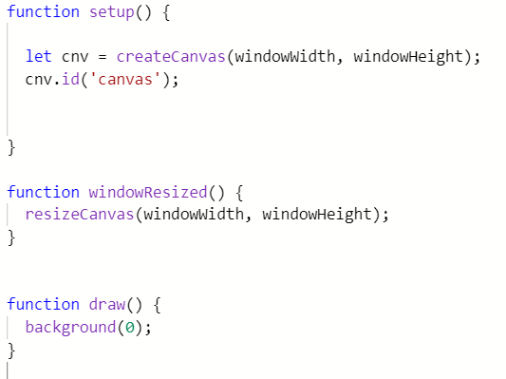
Canvas
Everything you create will be located on the canvas!
For the purposes of our game, our canvas will fill the whole screen.
Therefore we will utilize the windowWidth and windowHeight variables.
windowResized() will resize the canvas when the window is resized.
background(color) function fills the canvas with a designated color
(0 = black, 255 = white)
Let’s begin by creating the canvas:

Slide 9
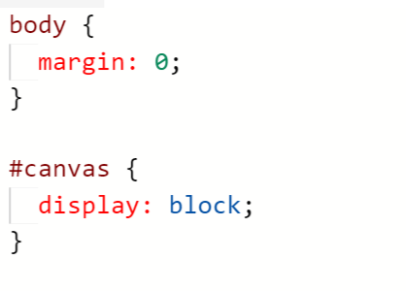
Canvas finishing touches
Go to your style.css file
The CSS file is responsible for styling the website, such as color and positioning
We will add these few lines of code to make sure that the canvas completely fills the window

Slide 10
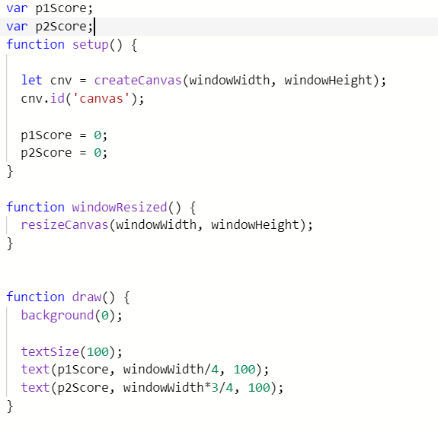
Score
Start by creating two variables, p1Score and p2Score (we will use these two variables to keep track of the store)
We must initialize the variables in setup() to zero, as both players begin with zero score
We will display the score in the draw() using textSize(size) and
text(text to display, x location, y location)
Add fill(255) before textSize()

Slide 11
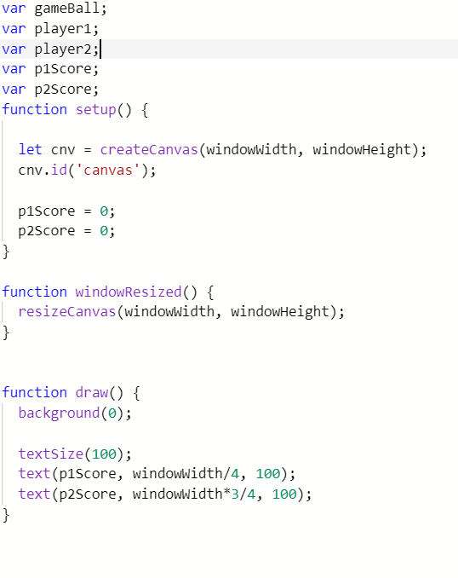
Create the other variables
Finish variable creation by creating a game ball variable, player 1 variable, and player2 variable.
Gameball will eventually hold the ball object and control its movements
Player1 and player2 variables will eventually hold paddle objects and represent the two players’ paddles

Slide 12
Before we start creating classes...
What is a class?
It’s a collection of data that represents a certain object
(ex. ball, paddle)
It holds variables and functions to help define the object and make the object function

Slide 13
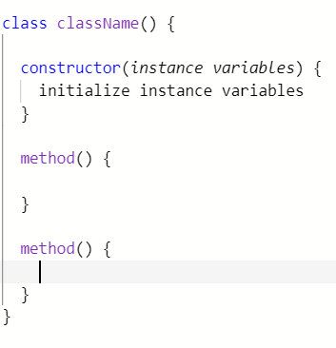
Basic class structure:
Start with defining the class name
Then create a constructor, where the variables of the object are created and assigned with values (ex. x position, size, color)
Finally create the functions that pertain to the object (ex. move(), update() )

Slide 14
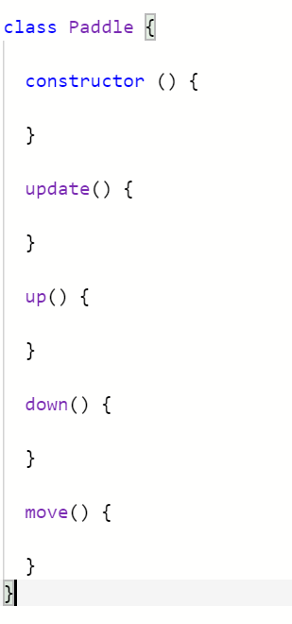
Let’s start with the Paddle Class!
This will create a class that will allow us to create the two paddles present in our game!
The beauty of classes is that we can make any number of objects under a single class.
Start by writing this skeleton:
update() - will display the paddle onto the canvas
up() will move the ball up
down() will move the ball down
move() will capture keyboard inputs to determine if the paddle moves up or down

Slide 15
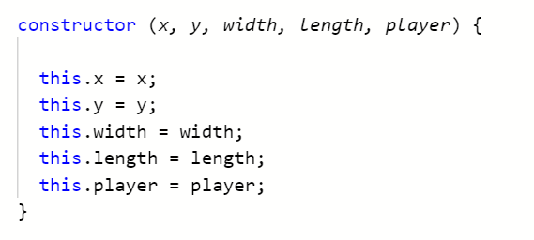
constructor()
This will allow the paddle to inherit basic characteristics, such as x, y, width, length, and player
Player will determine which player’s paddle it is.

Slide 16
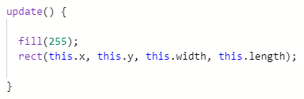
update()
This will draw the paddle on the canvas by creating a white rectangle.
rect(x location, y location, width, length)
Notice how we use x and y instance variables as the locations, so that the paddle will appear to be moving as the x and y location changes every frame.

Slide 17
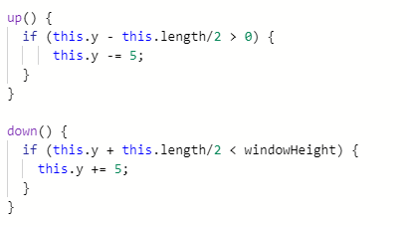
up() and down()
These functions will be responsible for moving the paddle up and down by changing the y position.
The if statements checks to see if the paddle exceeds the window height in order to prevent the paddle from moving out of the screen!
Take note: these functions are called helper functions because they aren’t directly called in our main function, or draw(), rather they are utilized in the move() function which we are going to program next.

Slide 18
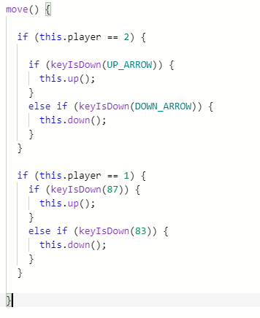
move()
This function captures user input and moves the paddle up or down by calling up() or down().
To separate player 1’s input from player 2’s input, we utilize the paddle’s player variable to determine which player’s key set to check for.
User input is captured through the keyIsDown() method, which checks if the key corresponding to the keycode (i.e UP_ARROW, 83) is held down.
87 = ‘W’ key
83 = ‘S’ key

Slide 19
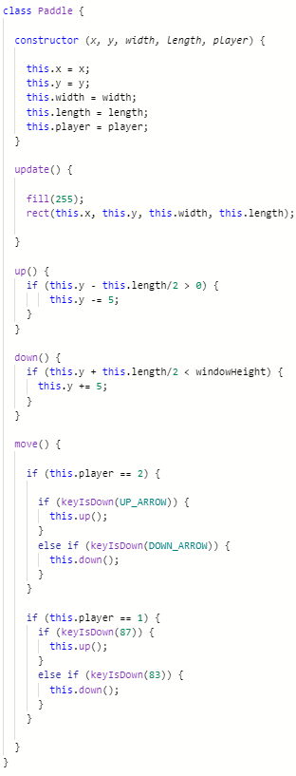
woohoo! We are done creating the classes!
Now time to put everything together!
But before hand, make sure your paddle class looks like this:
Check for anything you might’ve missed, especially the “this.” keyword and making sure your brackets match and line up.

Slide 20
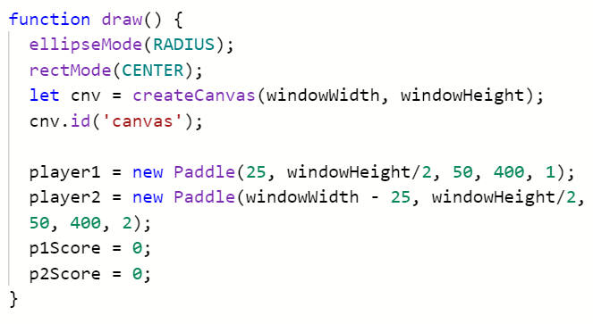
Implementing paddle class into setup()
First, we need to initialize and create the Paddle objects inside of setup()
Notice how we need to initialize two paddle objects, because two players need to be represented.
windowHeight/2 puts the paddle exactly halfway,
and 25 and windowWidth puts the paddle at edges.

Slide 21
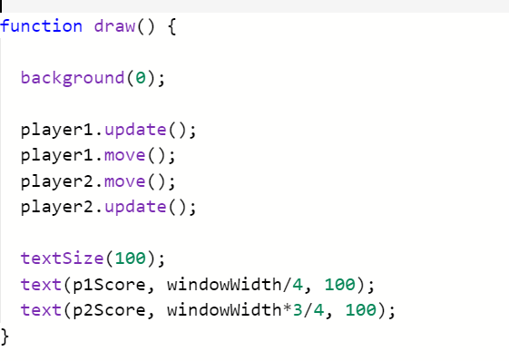
Add the paddles into draw()
This is the big moment! After you add the paddles into the draw() function, your game should be somewhat functional!
Reminder that update() will display and update the paddle’s position every frame, and move() will capture user input and change the paddle’s y-position accordingly

Slide 22
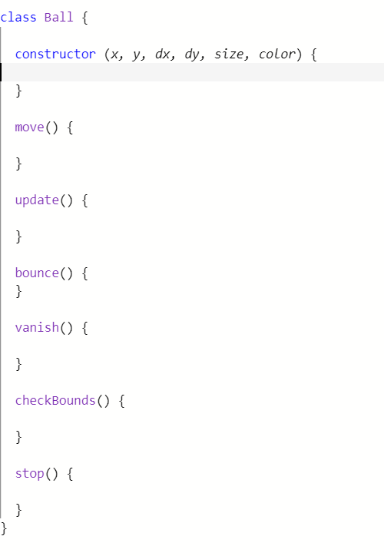
On to the BALL CLASS!
This class will represent the bouncing ball (duh) and it will allow us to create a ball object inside of our game!
The ball class will have a x location, y location, x speed (dx), y speed (dy), size, and color
Move() will allow ball to move every frame
Update() will display the ball onto the canvas
Bounce() will allow the ball to bounce on the edges and the paddles
Vanish() will make the ball disappear (for when game ends)
checkBounds() will see if the ball hit the edge of the screen
stop() will make the ball stop moving (for when game ends)

Slide 23
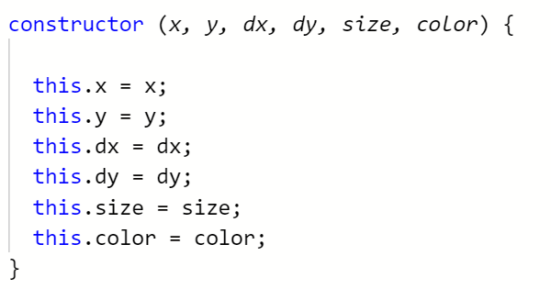
constructor()
This will allow the ball to inherit basic characteristics, such as position, speed, size, and color.
Take special note of the “this.” keyword. This is required every time you want to use an instance variable

Slide 24
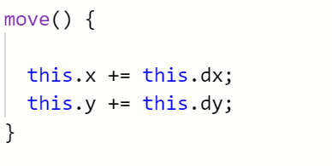
move()
This will facilitate ball movement.
This gives the ball a “speed” by adding a value to the x and y every frame.

Slide 25
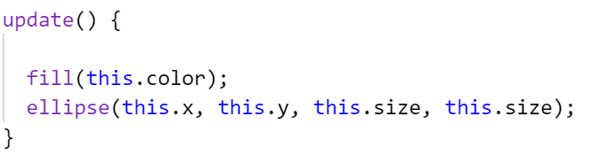
update()
This is the same idea as the paddle’s update method, but we are utilizing the ellipse() function, which draws ellipse on the canvas at x, y location with radius x and y

Slide 26
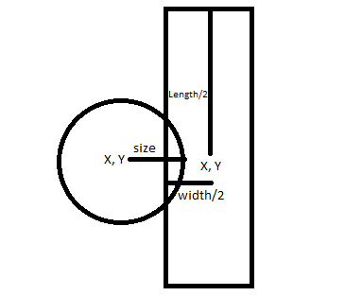
bounce()
To program the bounce function, we first need to learn about collisions!
Programming a collision between two objects will be a little difficult, so look at this diagram to have a better understanding of what’s going on:
A “collision” is detected when the sum of the x location and the radius of the ball is greater than the difference of the x location and half of the paddle’s width.
This logic can be follow for collision with top/bottom of screen

Slide 27
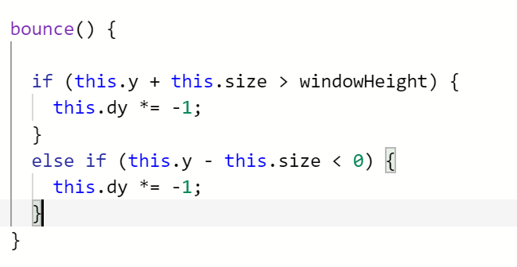
bounce() - top/bottom screen
The two if statements will check if the ball has traveled out of the top/bottom screen.
If it has, the y direction speed will be reversed, causing the ball to travel the opposite direction and creating a “bounce” effect

Slide 28
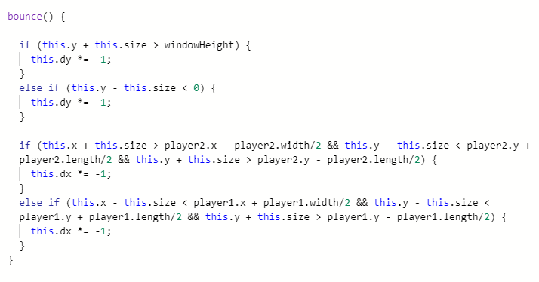
bounce() - Paddles
The two additional if statements looks like a lot to digest, but don’t worry it’s not too bad.
The first part of the condition checks if the ball has overlapped the paddle vertically, and the second and third parts check if the ball overlaps horizontally.
Notice how this time, we are reversing the x-position speed, because the ball should change directions vertically

Slide 29
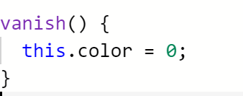
vanish()
Pretty simple function :p
This causes the ball to “vanish”
by changing the ball’s color to black and camouflage it with the background

Slide 30
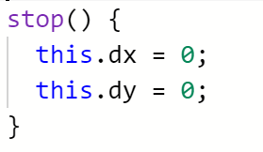
stop()
Another simple function :)
To make the ball stop, set the x speed and y speed to zero.

Slide 31
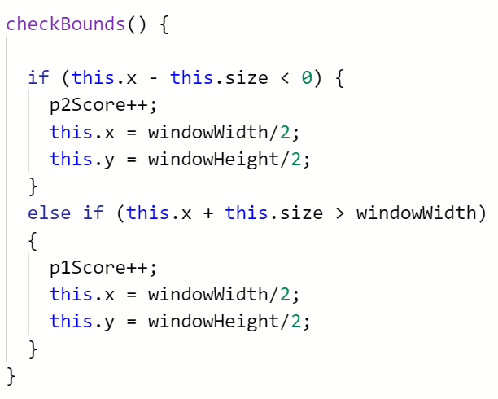
checkBounds()
Like the bounce function, this function will check if the ball “overlaps” a section of the screen.
If the ball overlaps the left or right side of the screen, a person has scored and the ball is repositioned to the center
p2score++ and
this.x = windowWidth/2,
this.y = windowHeight/2 reflects this.

Slide 32
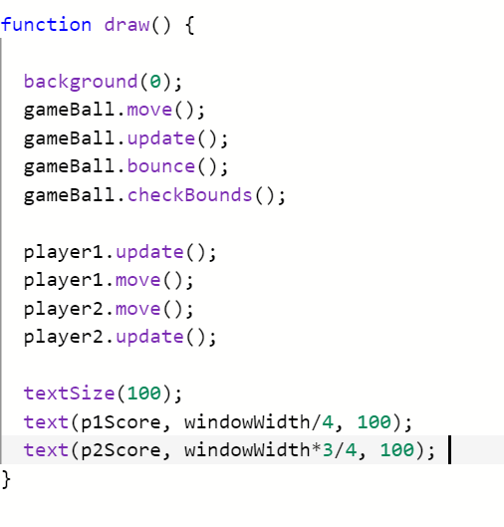
aanndd… we’re done with the Ball Class!
Let’s test it out!
Let’s set it up in the setup() function and draw it out in draw()!
Edit/Add to this line in your setup():
gameBall = new Ball(100, 100, 20, 20, 20, 255);
Notice how we create the ball in setup() by calling the constructor
We call all of the gameBall functions inside of draw() because we want to have them happen each frame.
Notes:
remove bounce() from screenshot

Slide 33
Finishing touches (game over)
The main “pong” game should be working now! The ball should be correctly bouncing off of the screen and paddles, and the paddles should be able to move through the ‘W’ and ‘S’ key or the up and down arrow.
But there’s one problem…
How do we stop the game? When should the game end?
No one likes a game that goes on forever!

Slide 34
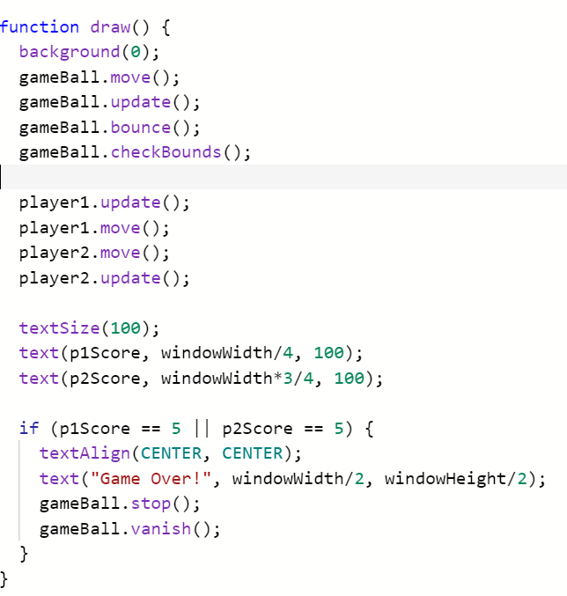
Game over screen
This is where we utilized the ball’s vanish and stop functions.
For the purpose of ending the game, we will cap the score limit at 5.
When either player’s score reaches 5, we will display the game over screen by printing the text “Game Over!” and making the ball disappear!

Slide 35
Whew! We’re all done!
Your game should have full functionality now, with the added game over screen.
I know that creating this game is a lot to digest (especially collisions), so if you have any questions, please ask me!
I challenge you to add additional features to this game, which might include importing an image to change the ball’s appearance, or changing the theme of the game entirely. Search up p5.js’ reference page to help you implement these features!
If any of you don’t know what to create for your Codeday project, I strongly recommend using what you just learned to create a p5.js project!

Slide 36
oh yea one more thing...
Here’s the github for this project:
https://github.com/Kaidriver/p5.js-pong-workshop
Go to it to find this presentation and the final source code

Slide 37
thanks for coming to my TED talk lol
no seriously, thank you :) uwu

Slide 38

Enjoy the rest of CodeDay DC!

